Slide 1
Seamless Montage for Texturing Models
Ran Gal Yonatan Wexler Eyal Ofek Hugues Hoppe Daniel Cohen-Or

Slide 2
Texturing 3D models
Notes:
In this project we are dealing with the problem of creating (CLICK) high-resolution detailed textures for 3D models.

Slide 3
Texturing 3D models
Notes:
In this project we are dealing with the problem of creating (CLICK) high-resolution detailed textures for 3D models.

Slide 4
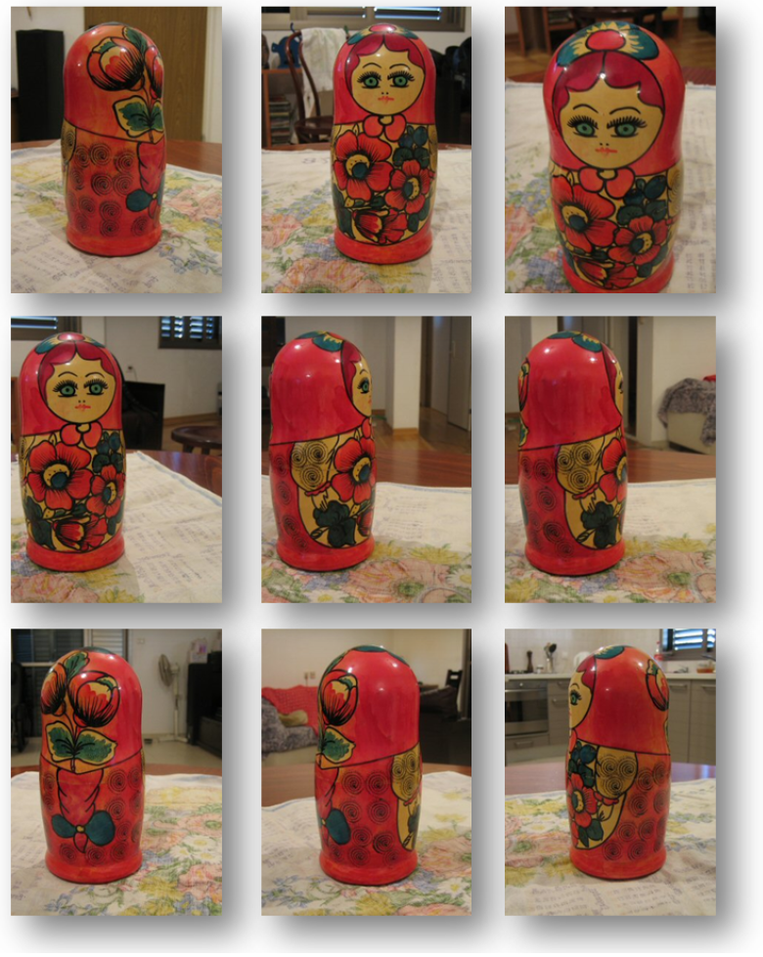
Casual Photographs
Notes:
A typical application or scenario would be one where we take a number of photographs around an object, using a held-hand camera.

Slide 5
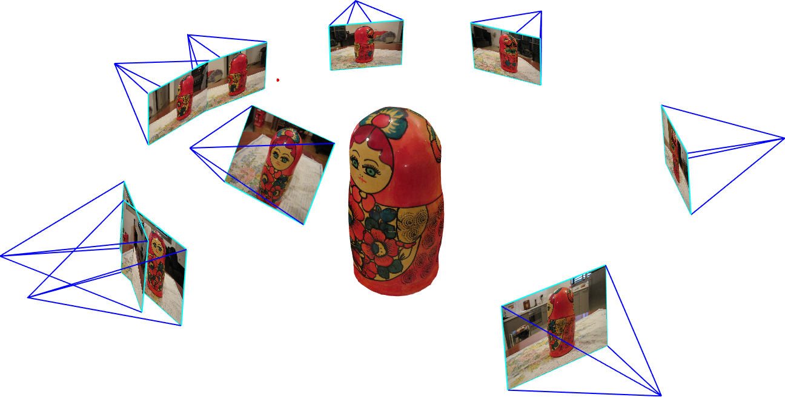
Registration
Notes:
Register them in a common coordinate system, for example by using bundle adjustment.

Slide 6
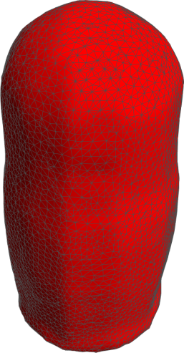
Geometry to be textured
Notes:
Recover the geometry that we want to texture.

Slide 7
Seamless Texturing
Notes:
And create a seamless and globally coherent texture for the object using the photographs.
Now, in an ideal scenario, where the geometric model is accurate, the views are perfectly registered, and there are no reflections or highlights, texturing can be archived by simply back-projecting each point on the surface to one of the views in which is it visible.

Slide 8
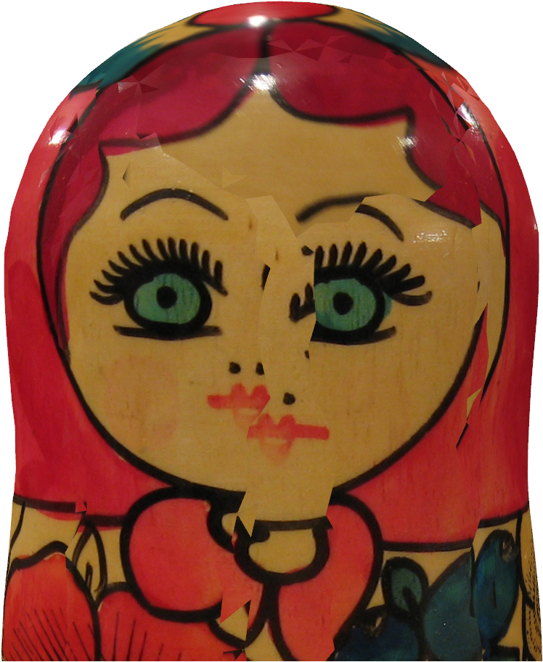
Things are not that simple
Notes:
However, in practice the reconstructed geometry is only approximated, the views are rarely registered perfectly, and the model is not Lambertian.
In this example we see a simple projection of some of the photos on the geometry – misalignments are obvious.

Slide 9
Previous Work
Calibration
Bundle adjustment – a modern synthesis [Triggs et al. 2000]
A silhouette based algorithm for texture registration and stitching [Lensch & Heidrich 2001]
Reconstruction
A comparison and evaluation of multi-view stereo reconstruction algorithms [Seitz et al. 2006]
Scene reconstruction from multiple views [Dyer 2001]
The visual hull concept for silhouette-based image understanding [Laurentini 1994]
Notes:
Image-based modeling has been researched extensively over the last decade.
It involves a sequence of challenging tasks including calibration, registration, reconstruction, and texturing.
Each of these steps can be done in a number of ways and adds some degree of uncertainty and errors.

Slide 10
Previous Work
Texturing
Optimal texture map reconstruction from multiple Views [Wang et al. 2001]
Blending images for texturing 3D models [Baumberg 2002]
Seamless mosaicing of image-based texture maps [Lempitsky & Ivanov 2007]
Matchmaker: constructing constrained texture maps [Kraevoy et al. 2003]
Interactive decal compositing with discrete exponential maps [Schmidt et al. 2006]
Flexistickers: Photogrammetric texture mapping using casual images [Tzur & Tal 2009]
Notes:
In this work we focus mainly on the texturing task.
As each image covers only part of the object, we must combine the sources to form a single coherent texture.
(CLICK)
Several techniques form the texture by blending the available images.
One drawback of blending is that it can lead to ghosting and blurring artifacts when the textures are geometrically misaligned.
(CLICK)
To reduce such artifacts, Lempitsky and Ivanov [LI07] pose texturing as an image stitching problem.
Each surface triangle is projected onto the images from which it is visible, and its final texture will be assigned entirely from one image in this set.
The goals are to select the best texture source and to penalize mismatches across triangle boundaries.
(CLICK)
Several recent techniques provide semi-automated tools to allow user placement of texture content onto shapes.
In this work we aim at automatically select content from among multiple photographs while minimizing seams between the mapped regions.

Slide 11
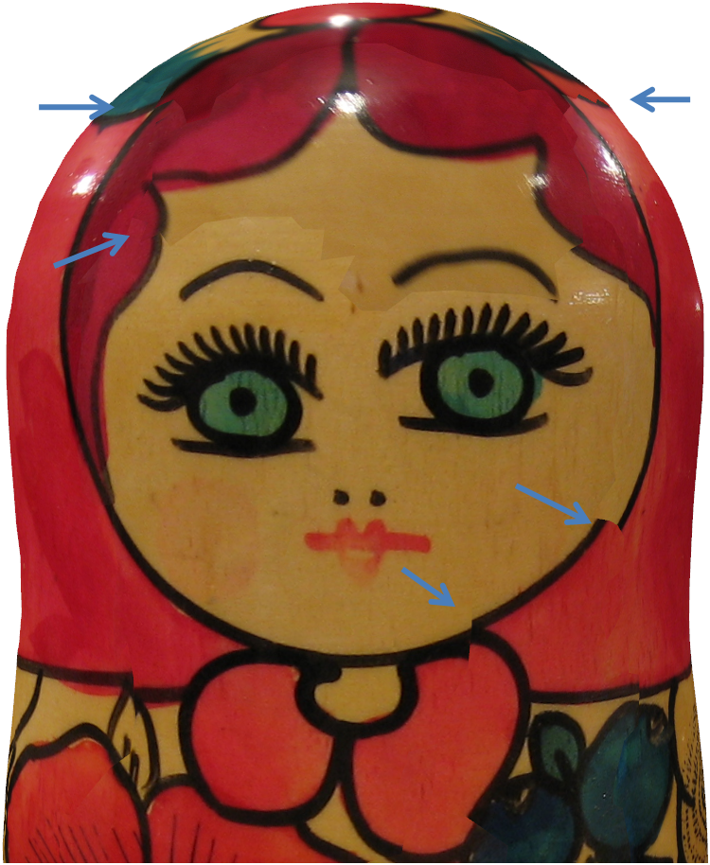
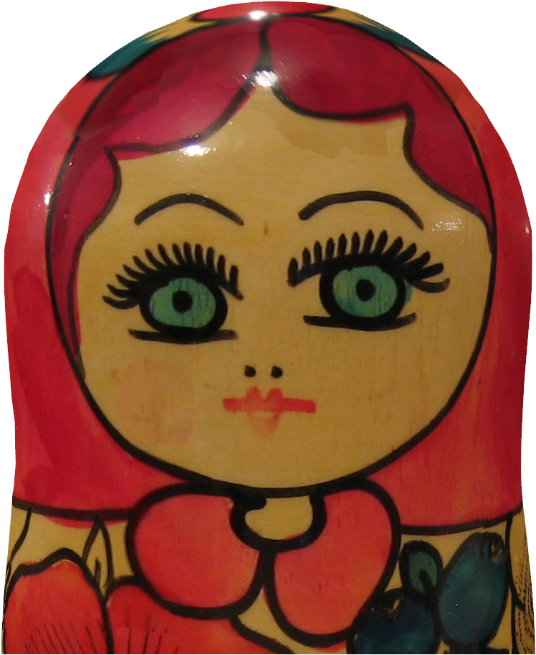
Our Contribution
Simple back-projection
[Lempintsky & Ivanov]
Our solution
Notes:
So, we have seen that a simple back-projection does work in practice.
(CLICK)
Lempitsky and Ivanov reduce the number of artifacts in such cases, but still have problems when with mis-alignments.
(CLICK)
Our approach builds on their work, with two major differences.
We expand the combinatorial search to consider local image translations; this change lets the technique compensate for calibration and reconstruction errors.
Second, to eliminate the residual lighting variations, we rely on Poisson blending in the texture image domain.

Slide 12
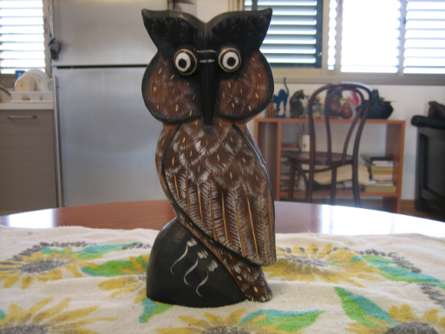
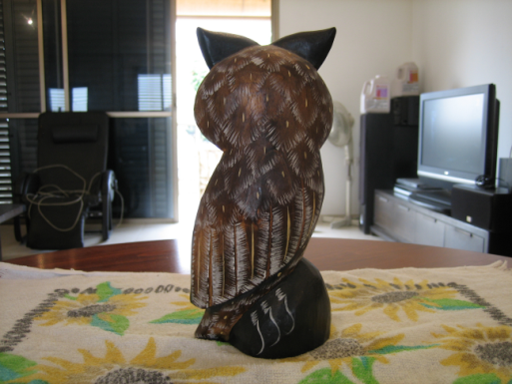
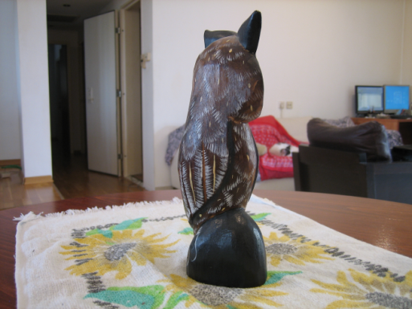
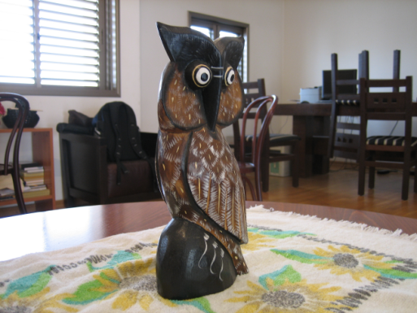
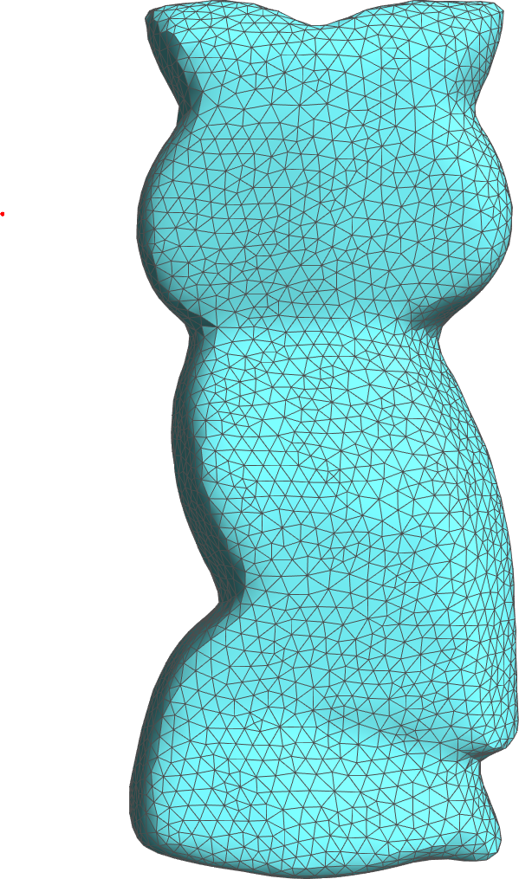
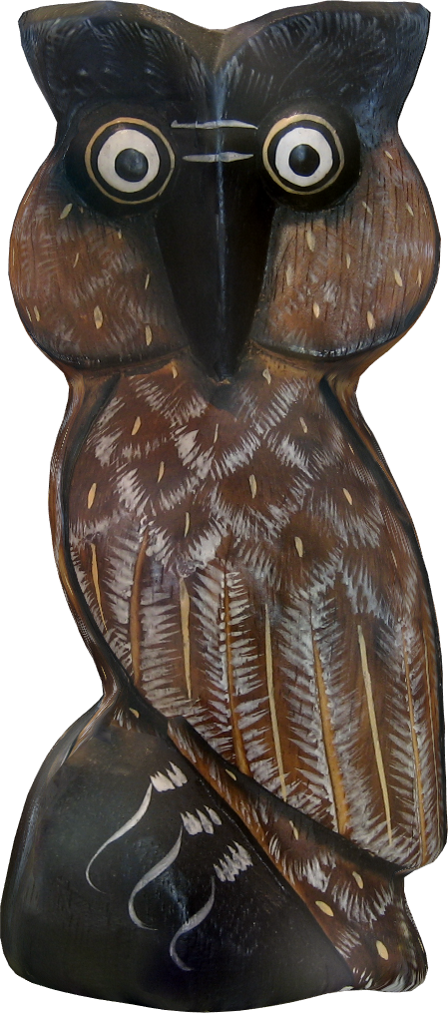
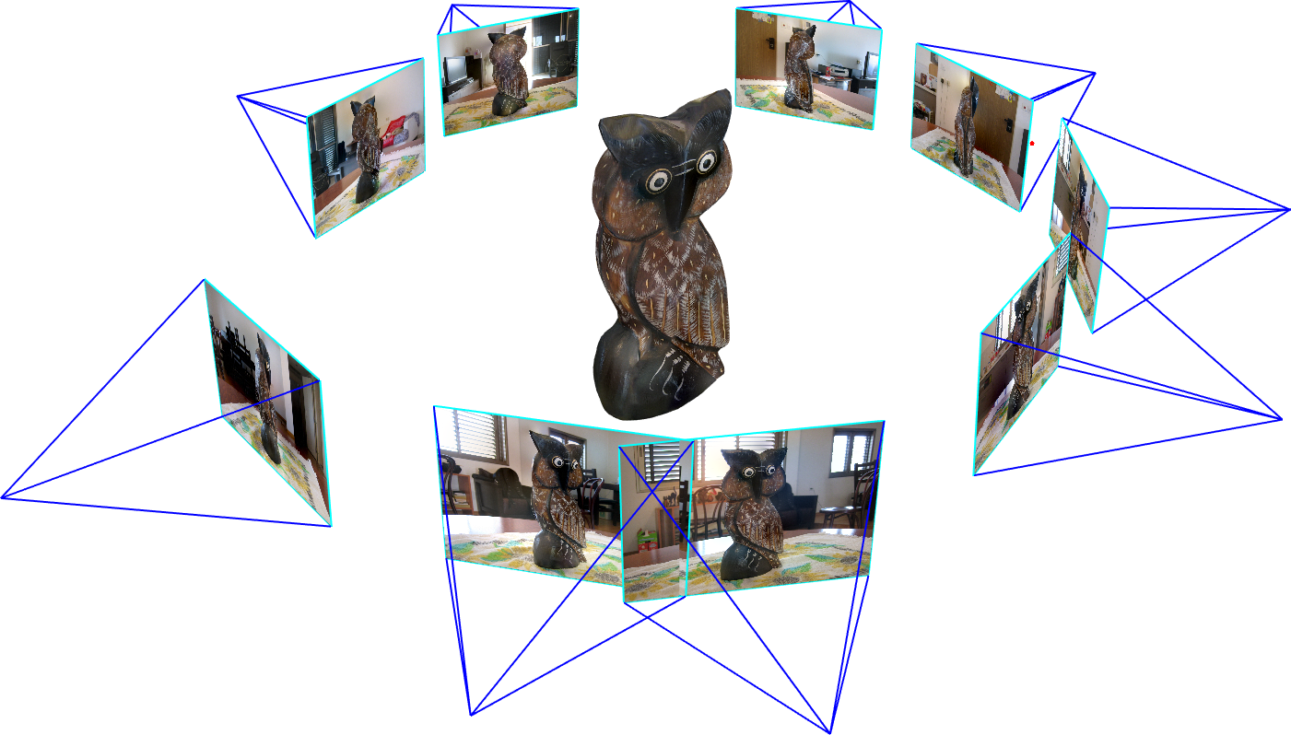
Our Method
Notes:
So, we start by taking a number of photographs (CLICK) and bring them into a common coordinate system.
(CLICK)
Once the photographs are registered, the object geometry can be modeled.
We chose a relatively simple method based on visual hull computation. We manually segment the object in a number of images, and apply silhouette carving.
A surface triangle mesh is then generated using marching cubes, and is smoothed and simplified to create an approximate model.
(CLICK)
We then use these photograph and geometry to create the final texture.

Slide 13
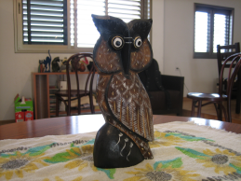
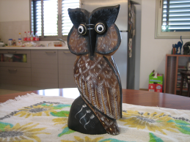
Candidate Textures for Triangles
Enrich the candidates with image based translations
Image 1
Image 2
Notes:
The texture on each mesh triangle (CLICK) is defined by projecting the triangle face onto one of the input images.
(CLICK) (CLICK)
This projection between faces and images uses the camera parameters and the mesh geometry.
We seek to assign a label to each face that identifies its associated input image.
This label assignment has two goals:
selecting texture content with high resolution and contrast, and
(2) forming seamless texture joins between adjacent triangles.
(CLICK)
Our contribution is to allow additional degrees of freedom into the texture projections to compensate for inaccuracies in the image acquisition, bundle adjustment, and particularly the geometric model.
This additional flexibility results in significantly fewer seam artifacts in the final surface texture montage.

Slide 14
It is about Shifts
3D surface triangles
Image 1
Image 2
Notes:
I’ll use the following example to illustrate the idea.
Suppose we have two triangles on the model’s surface, that are seen by two views.
(CLICK)
Projecting the textures as seen in image 1 result in the following.
(CLICK)
Projecting the texture from Image 2 result in a different texture.

Slide 15
It is about Shifts
3D surface triangles
Candidate 2
Candidate 1
Candidate 0
Image 1
Image 2
Notes:
Now, if the solution will assign the left triangle to image 1 and the right triangle to image 1, no amount of blending will be able to fix this problem.
In our solution, instead of using only the one candidate for the right triangle from image 2, (CLICK) the yellow one
(CLICK)
We translate the texture source in image space (CLICK) and create another texture candidate for this triangle to appear in the solution.
(CLICK)
We do it again, shifting in a different direction (CLICK), and thus enriching the solution space
(CLICK)

Slide 16
It is about Shifts
3D surface triangles
Candidate 2
Candidate 1
Candidate 0
Image 1
Image 2
Notes:
We do the same thing to all the triangles and solve (CLICK) to create a globally coherent textures with less visible artifacts.
Note that every view sees only part of the model, so we need to move at some point from one view assignment to another.

Slide 17
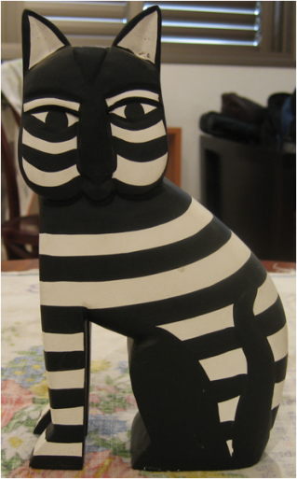
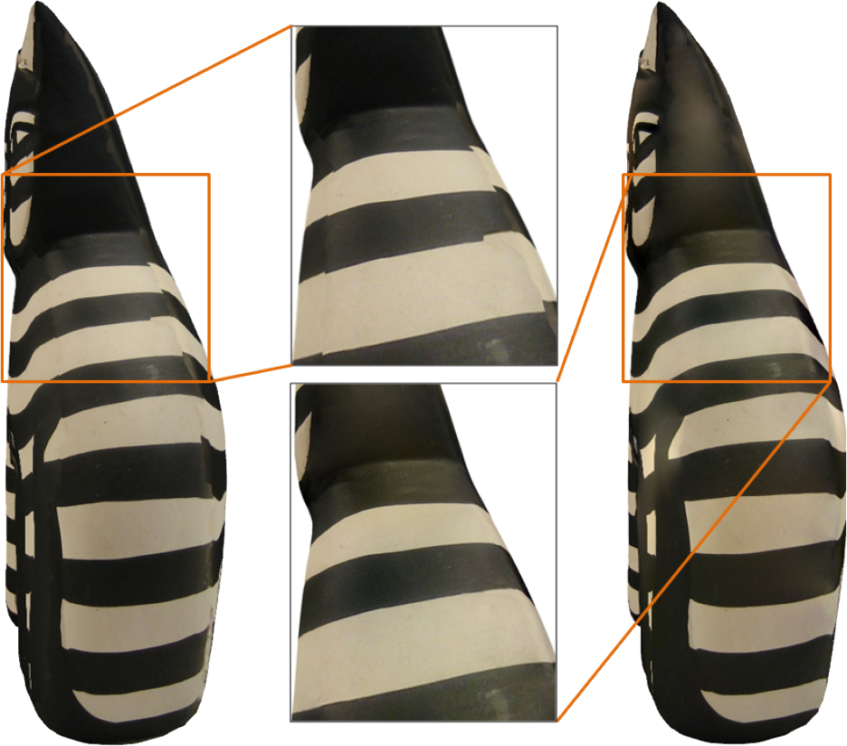
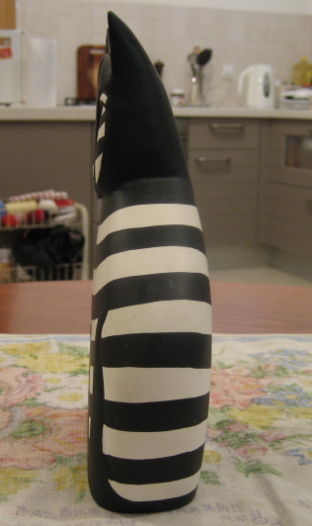
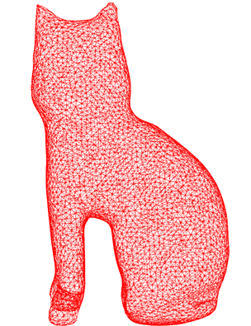
Notes:
In this example of a black-and-white cat, you can see two of the source images (on the left)
The model was textured without allowing shifts – you can notice the mis-alignments at the seams between different views.
(CLICK)
Introducing shifts allows for a smoother solution.
(CLICK)

Slide 18
Formulation as an MRF problem
3D surface triangles
Few places in Image 1
Few places in Image 2
Pair-wise cost for neighboring mesh triangles
Notes:
So, in our formulation, each mesh triangle serves as a node in a graph.
(CLICK)
We expand the space of face labels (CLICK) to include an image-space translations, which is applied after the projection in image space.
The label associated to each triangle face thus consists of a source image and 2D translation vector.
So why only translations? Accommodating the registration and modeling errors would seem to require a full perspective correction.
The intuition is that among the possible view rotation errors, pitch and yaw effectively result in image translation; it is only roll that presents a problem, and it is usually recovered accurately by bundle adjustment.
So, in practice, translation in image space was enough for all our tests.
(CLICK) (CLICK)
We measures the texture discrepancy between adjacent triangles by comparing the color differences in a neighborhood of the shared edge.

Slide 19
Objective Function
Markov Random Field (MRF) problem which is solved using the method of [Kolmogorov, 2006]
We employ Coarse-to-Fine scheme for efficiency
Notes:
So, our objective function is this one.
(CLICK)
Where the first term seeks to texture each face from the “best” image that sees it. It does so by integrating the total image variation mapped onto the triangle, in image space.
This definition incorporates the effect of foreshortening, image resolution, and blur.
(CLICK)
The second term seeks textures on adjacent faces whose colors agree in a neighborhood of their shared edge.
Typically, the natural result of the optimization will be a set of mesh charts, each containing faces with similar or identical labels, so that most of the error is concentrated on the boundaries between the charts.
(CLICK)
This objective function forms a Markov Random Field (MRF) problem, in which the graph nodes correspond to the mesh faces and each node has a discrete set of possible labels.
We solve this MRF problem using the method of [Kol06].
(CLICK)
For efficiency, we perform the optimization in an iterative coarse-to-fine scheme.
The images are coarsened in a Gaussian pyramid.
We then solve it for the coarsest level and use the solution to seed the candidate labels in the next finer level.

Slide 20
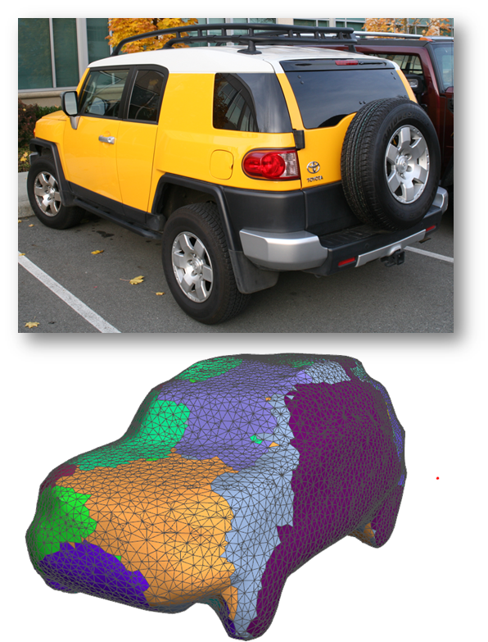
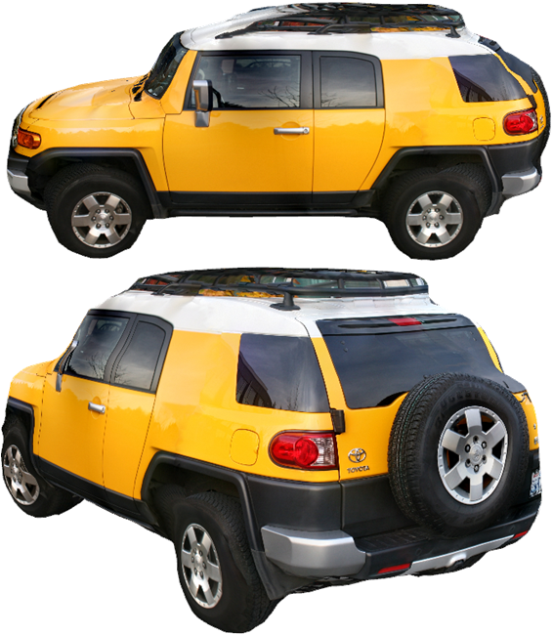
Notes:
Here is an example of texturing a car.
On the left you can see one of the casual photographs, and the labeled mesh generated by the optimization.
On the right are two views of the textured model.

Slide 21
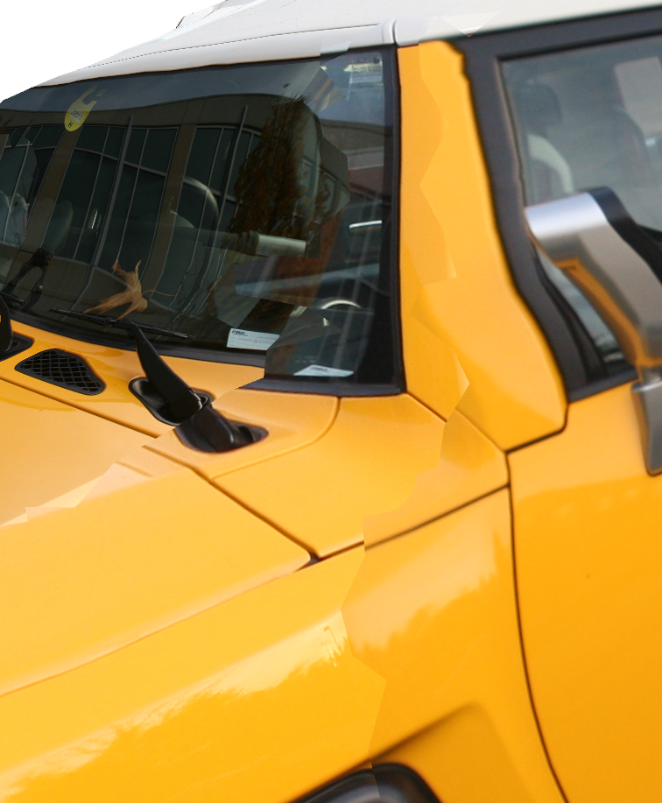
Iteration 0
Notes:
In this close up view, you can see the effect of the adding the additional shifts.
Iteration 0 is in fact the result of Lempinsky and Ivanov.
You can see the apparent artifacts (CLICK) due to the errors in geometry and registration.

Slide 22
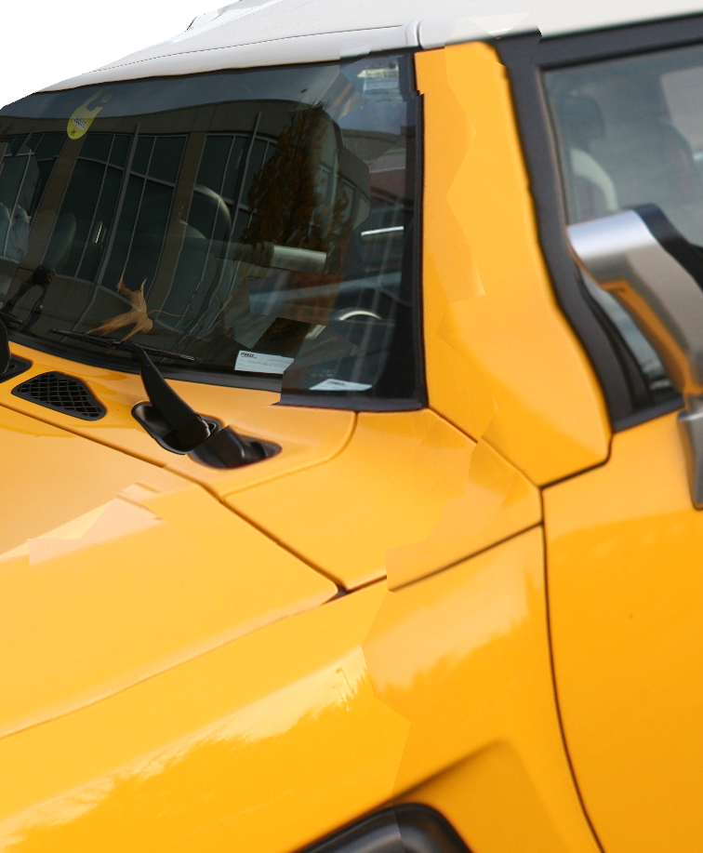
Iteration 2
Notes:
After two iterations.

Slide 23
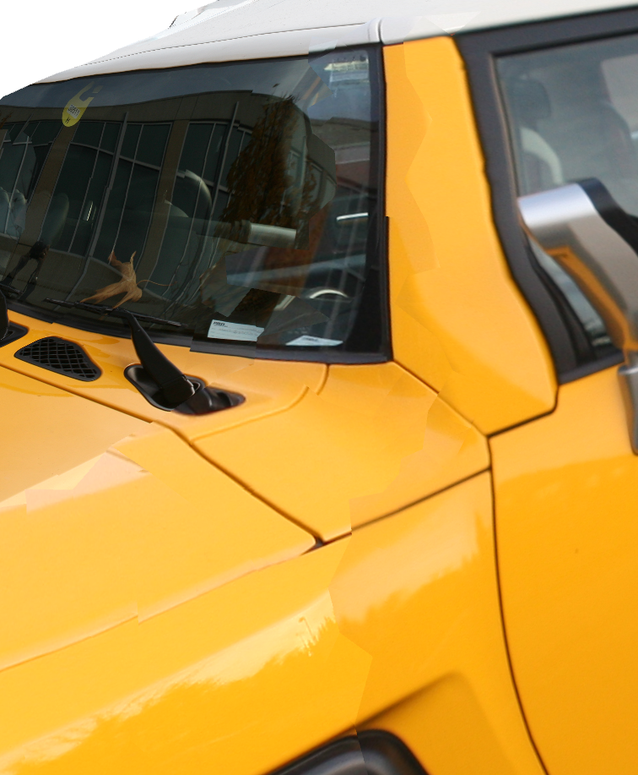
Iteration 4

Slide 24
Iteration 6

Slide 25
Iteration 10
Notes:
After 10 iterations, the number of artifacts is much smaller.

Slide 26
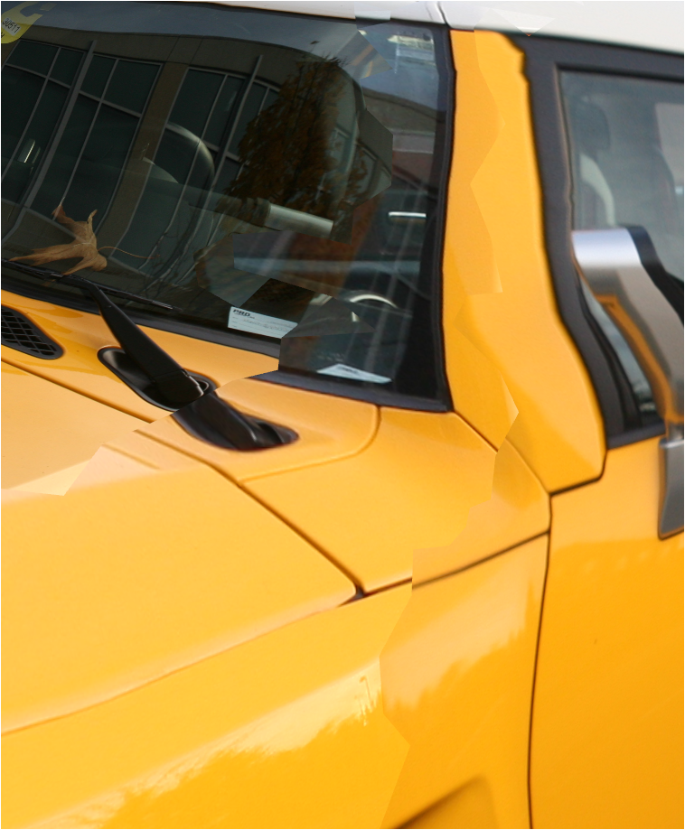
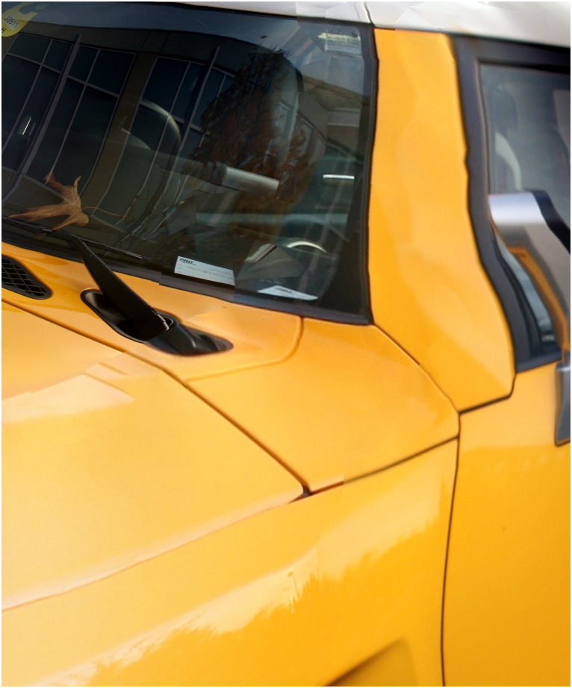
Color Correction
Notes:
The discrete optimization can deal with large errors.
One effect that remains after textural alignment is local variations in luminosity.
These create small but noticeable artifacts as can be seen here.
(CLICK)
To resolve this problem, we use poisson blending, applied to the input textures.
(CLICK)
Solving this step for pixels in image space (rather than for mesh vertices) lets us leverage algorithms optimized for solving Poisson equations on regular grids.

Slide 27
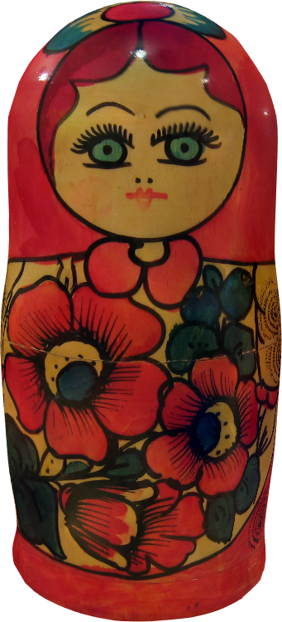
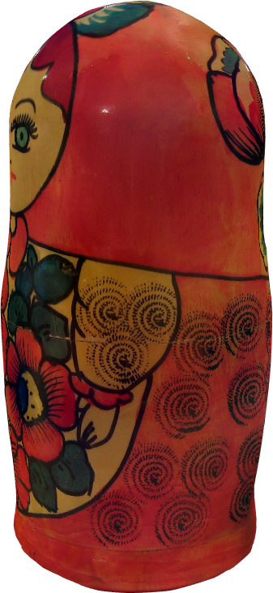
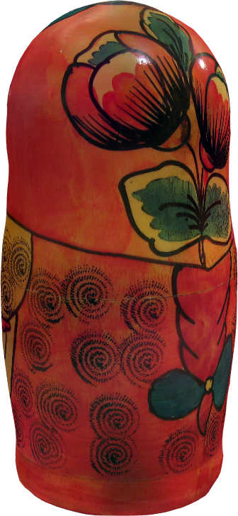
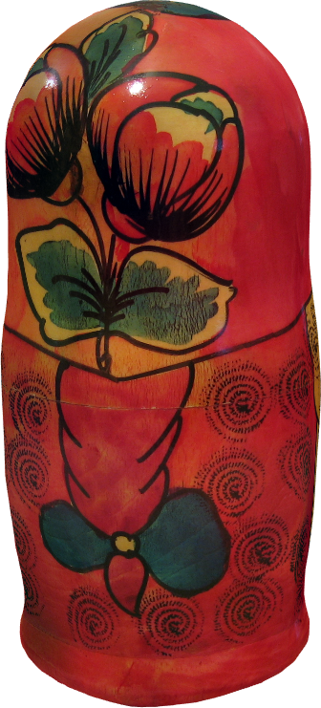
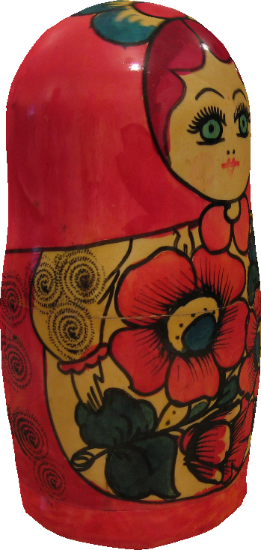
Notes:
So here are a number of results of our algorithm.
The models on the bottom row are rendered from the same point of view as the corresponding images. the rightmost image was not used in the texturing and is used as a leave-one-out test.

Slide 28
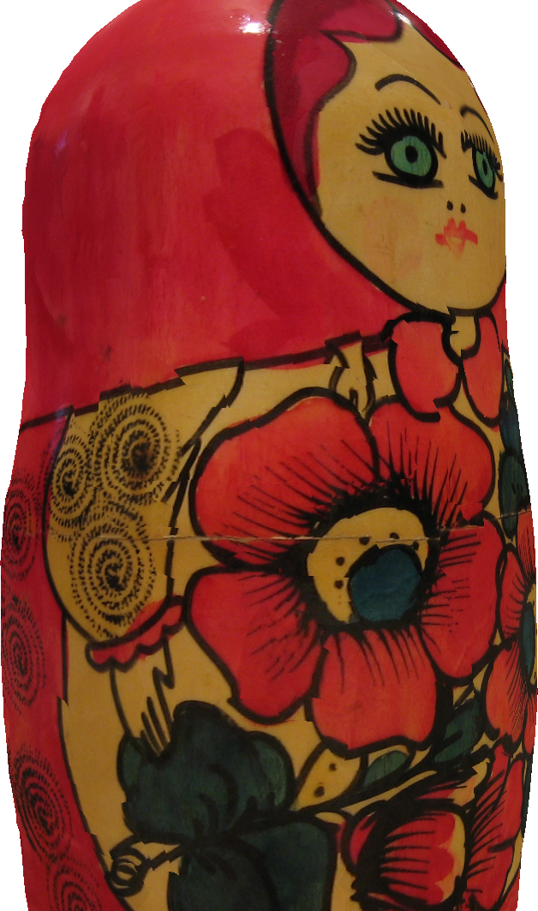
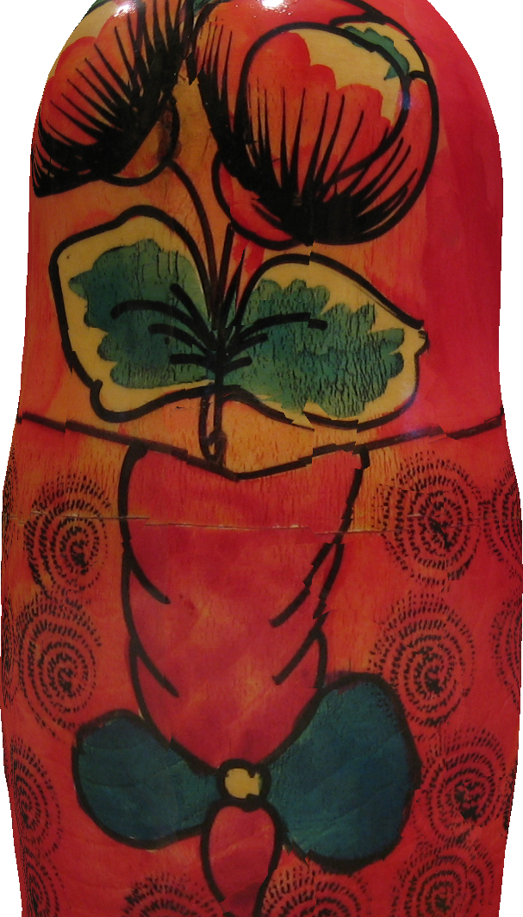
Iteration 0
Notes:
Here is the iteration progress, starting at a solution that contains many (CLICK) apparent artifacts.

Slide 29
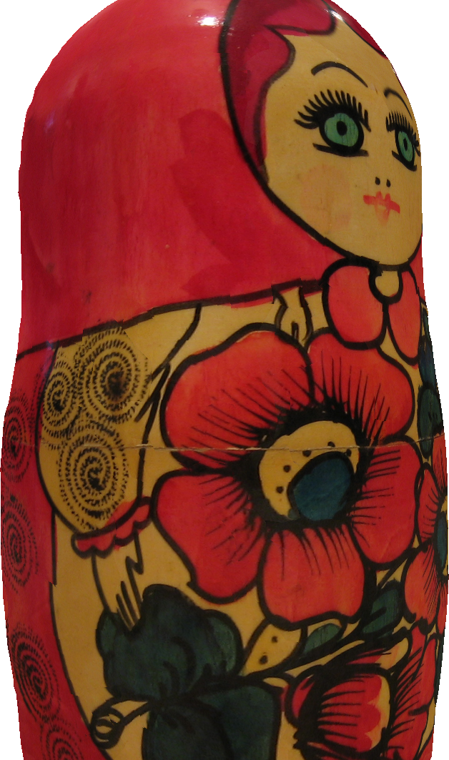
Iteration 2

Slide 30
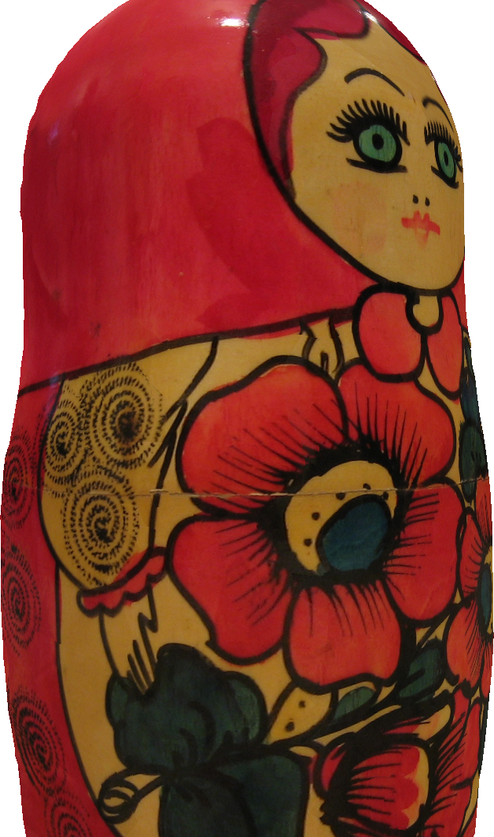
Iteration 4

Slide 31
Iteration 6

Slide 32
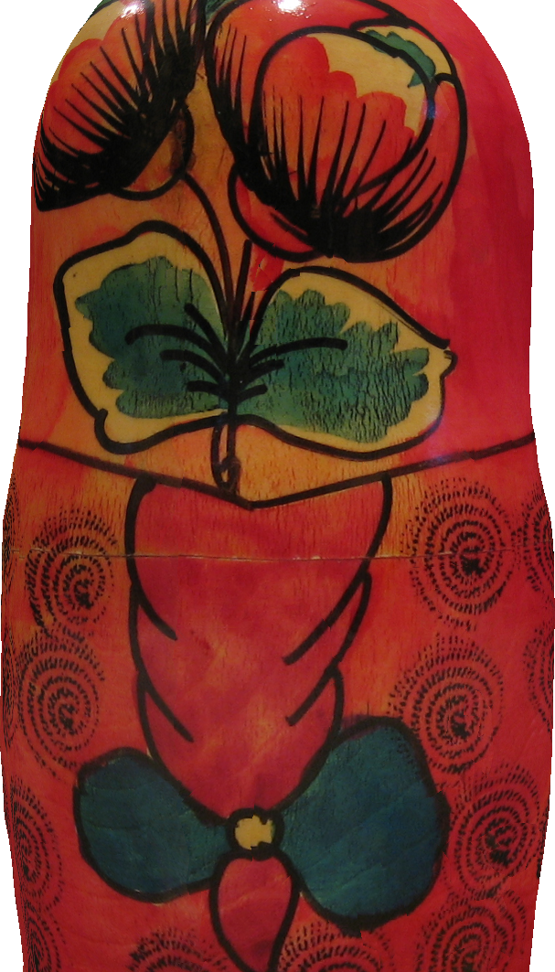
Iteration 8

Slide 33
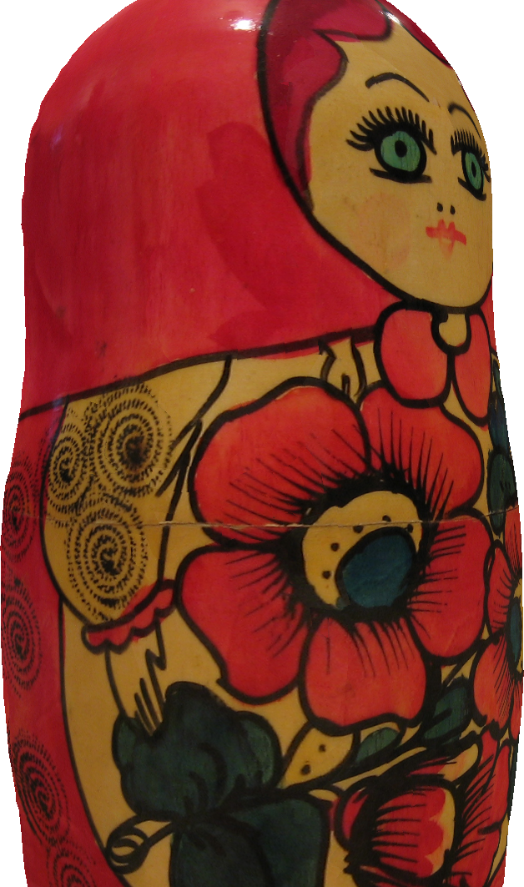
Iteration 10

Slide 34
Iteration 12

Slide 35
Iteration 15
Notes:
The final texture.

Slide 36
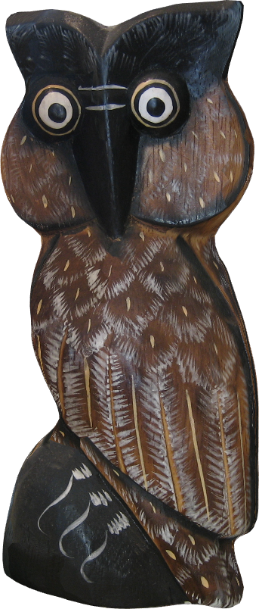
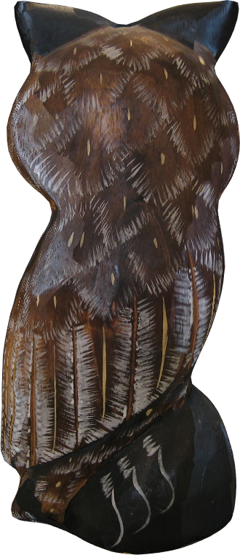
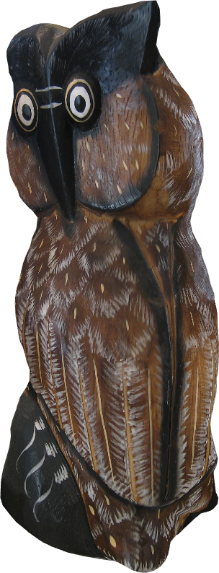
Notes:
Another example. Again, the rightmost image was not used in the texturing and is included for evaluation of the result texture.

Slide 37
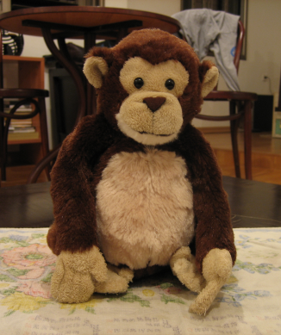
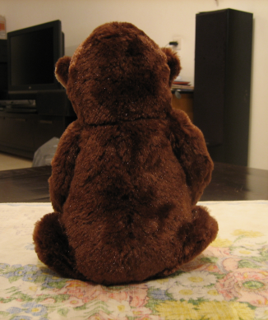
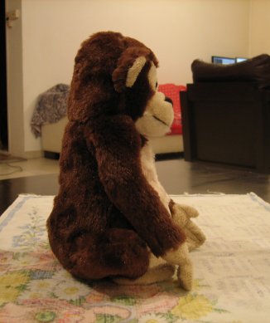
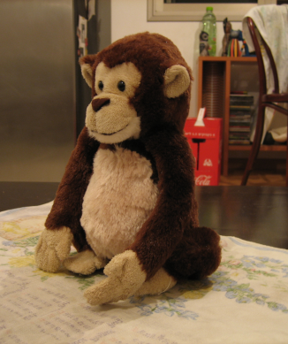
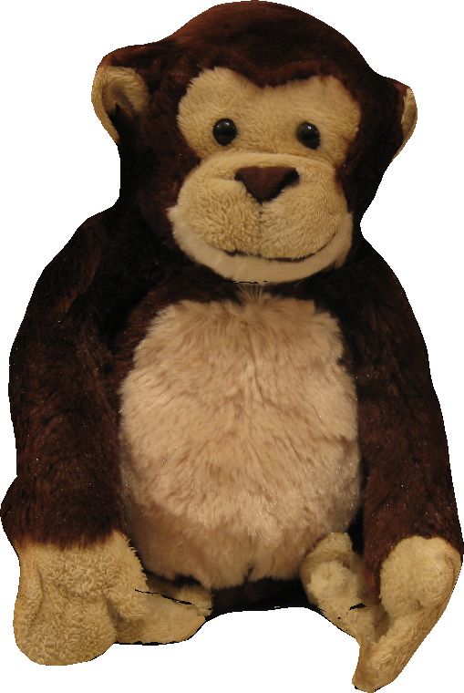
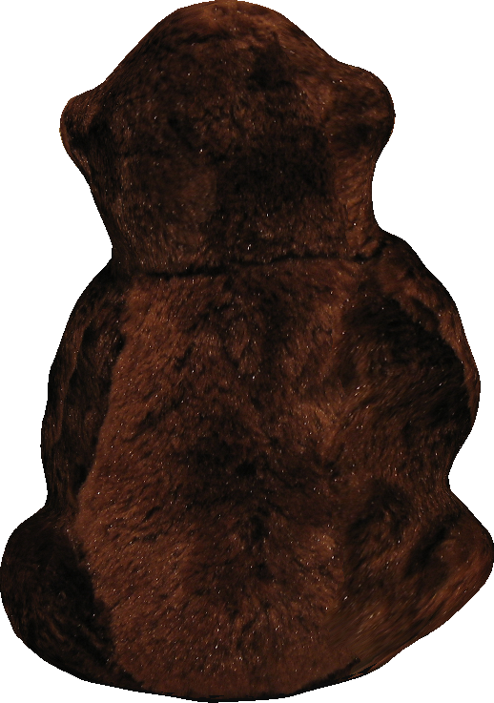
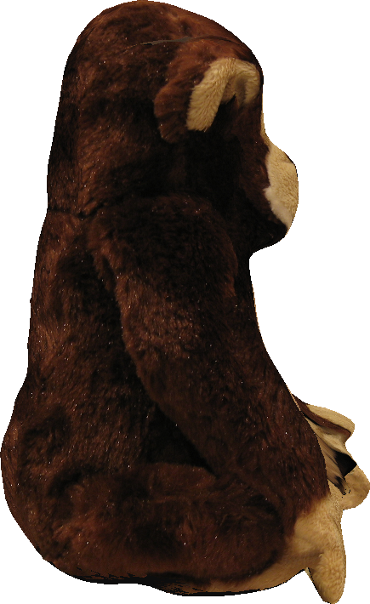
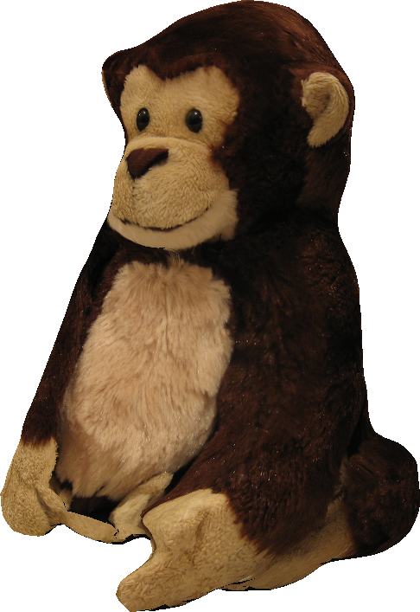
Notes:
And another example of a fury doll…where the detaled texture capture the feeling of the fur.

Slide 38
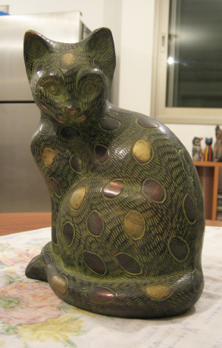
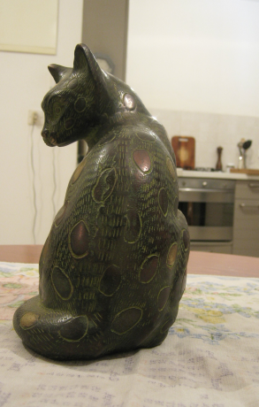
Notes:
And another,

Slide 39
Notes:
Here are some close-up views of the cat texture.
The top row is the solution without shifts, while the bottom is the one with shifts. (CLICK)
(CLICK)
Note that in the rightmost example (CLICK), the shifts do not successfully recover a seamless texture, due to large errors in the geometry.

Slide 40
8000 triangles
1200 triangles
Notes:
Here we compare our texture montages on different geometries.
We used a fine mesh with 8000 triangles (the left one) and a coarse one with 1200 triangles (on the right)
The reconstructed texture remains seamless, despite the significant geometric errors in the surface such as those evident near the ears

Slide 41
Notes:
A side by side comparison of the input images and the textured model.
The modeled geometry differs from the original one, resulting in a seamless texture that resembles the original model and is globally consistent.

Slide 42
Assignment
Assignment
Our Result
[LI07]
Notes:
Another textured model comparison between [LI07] and our result.

Slide 43
Notes:
Another example where the geometry is a very crude representation of the original model, missing a lot of the geometric details (such as the eyes), but the resulting texture is still globally coherent and able to capture the visual appearance.

Slide 44
Notes:
This is an example of over-smoothed geometry that still results in a plausible texture.

Slide 45
Conclusions & Future Work
Practical technique for seamlessly texturing a 3D model from a set of casual photographs.
Robustly handling inaccuracies in input including shape and alignment errors.
Use automatic geometry-to-image correspondences of salient features to better align important regions.
Notes:
We presented a practical technique for seamlessly texturing a 3D model from a set of casual photographs.
We robustly handle inaccuracies in input, including shape and alignment errors
In the future we would like to automatically identify both geometric and image based features and use them to better align salient regions of the model.

Slide 46
Thank You

