Slide 1
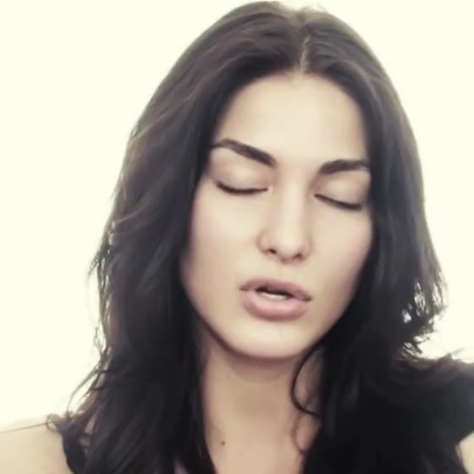

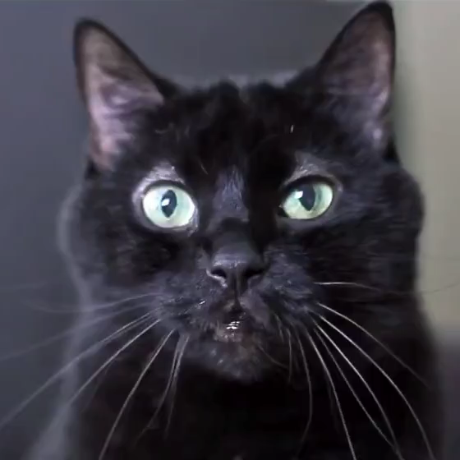



Semi-Automated Video Morphing
Jing Liao, Rodolfo Lima, Diego Nehab
Hugues Hoppe, Pedro Sander
Notes:
Thanks for the introduction and also thank you all for coming to my talk.
Our paper “Semi-Automated Video Morphing” is a joint work of HKUST, IMPA and Microsoft research. It proposed a semi-automatic method to create smooth transitions between videos of different scenes.
As shown here, the left and the right one are input videos ,and the middle one is the output morph. In the morph, we can find both the alignment of spatial features and the synchronization of local motions are obtained. We achieve this by spatiotemporal optimization with relatively little user guidance.

Slide 2
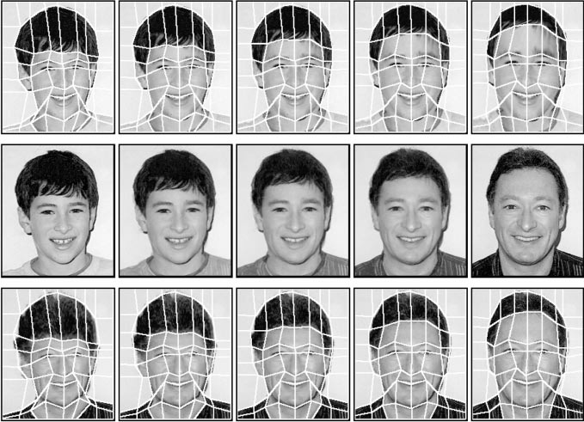
Related work
--image morphing
Mesh-based
Line-based
Point-based
Image content based
[Smyth 1990, Nishita 1993, Wolberg 1990]
Notes:
To review the previous work, video morphing can be seen as the extension of image morphing.
Image morphing is an old topic of computer graphics. There are lots of research on image morphing. According to the feature correspondences used for morphing computation, previous methods can be categorized into four types: mesh-based, line-based, point-based and image content based.

Slide 3
Related work
--image morphing
Mesh-based
Line-based
Point-based
Image content based
[Beier 1992, Lee 1998]
Notes:
Lines

Slide 4
Related work
--image morphing
Mesh-based
Line-based
Point-based
Radial basis function [Arad 1994]
Thin plate spline [Lee1994, Lee 1996, Litwinowicz 1994]
MFFD [Lee 1995]
Mass-spring system [Choi 2011]
Image content based
Notes:
Points
In the first three kinds of methods, morphing is totally depends on user inputs, no matter in what forms, mesh, points or lines. Mapping function is just the interpolation of user specified correspondences. As a results, users have to specify lots of correspondences to make the mapping function accurate. Otherwise, ghosting effects will happen.

Slide 5
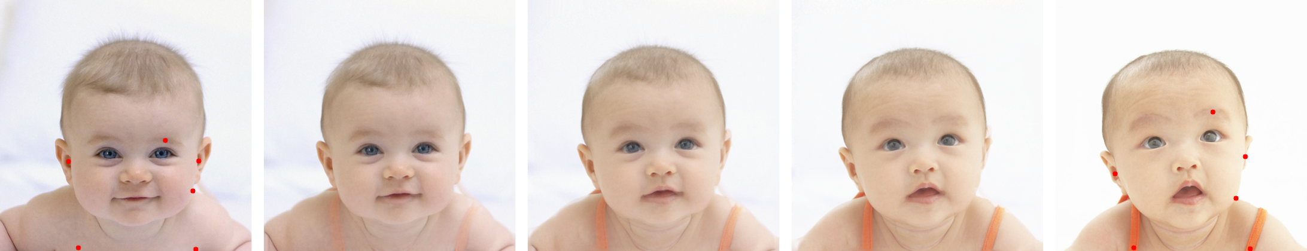
Related work
--image morphing
Mesh-based
Mesh-based
Model [Yang 2012]
Line-based
Line-based
Texture [Liu 2002]
Point-based
Point-based
Color/intensity [Gao 1998]
Image content based
Image content based
SSIM [Liao 2014]
Notes:
To solve this, recently, many works began to use image contents as automatic features in addition to manual specified features. There are different kinds of image contents can be used as features, like the facial model, the texture pattern and color.
The last one is our previous work of image morphing. we use the structural similarity ssim of small neighborhood to guide the morphing. Compared the other methods, ours are more general and more automatic.
Our video morphing leverage some methods from this image morphing paper. If you are interested to it, this work is going to be presented in siggraph this year.

Slide 6
Related work
--video morphing
Motion and Feature-Based Video Metamorphosis
[Szewczyk 1997]
Apply motion estimation techniques to track feature lines. Morphing uses line-based algorithm.
Perform video matting and apply morphing separately to each video layer.
Notes:
Despite the large amount of work on image morphing, video morphing is much less mature. There are only two papers we can find about video morphing.
This paper use feature-tracking methods to transfer manually specified feature lines from one frame to the next, in order to ease the burden of user. After transferring features, the morphing of each frame is conducted by the line-based image morphing method.

Slide 7
Related work
--video morphing
Detect and propagate features by a feature tracking algorithm followed by user correction.
Frame-to-frame mappings are achieved by optimizing color similarity, and spatial coherence.
Video Metamorphosis
Using Dense Flow Fields
[Yu 2004]
Notes:
This work also propagates features by a feature tracking algorithm.
And then they do the image morphing on each frame pair by optimizing the energy function composed by color similarity, and spatial coherence term.

Slide 8
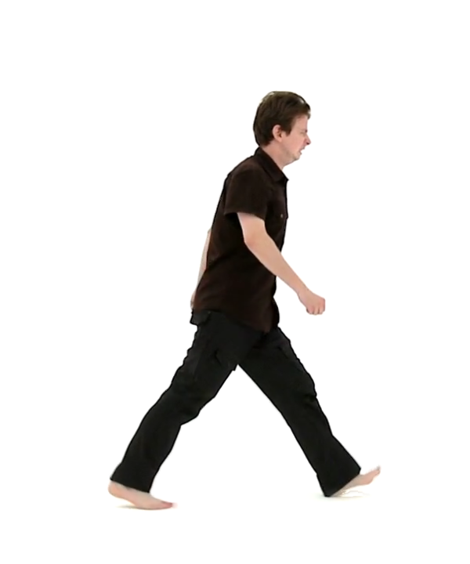
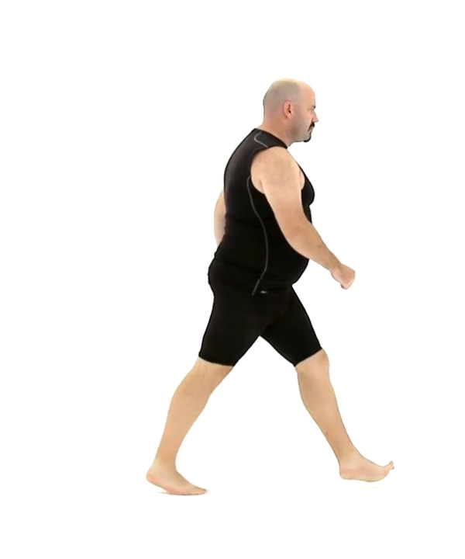
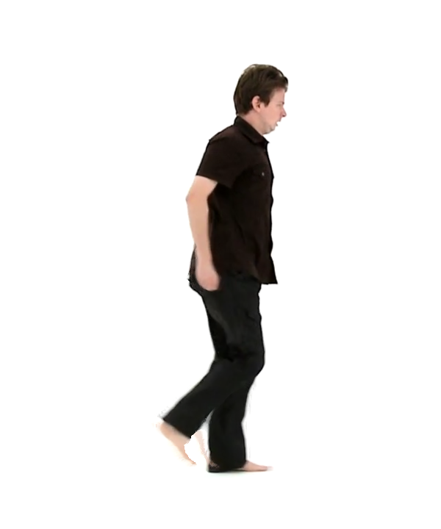
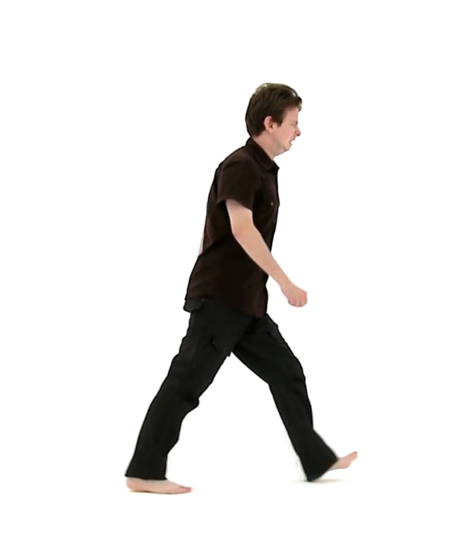

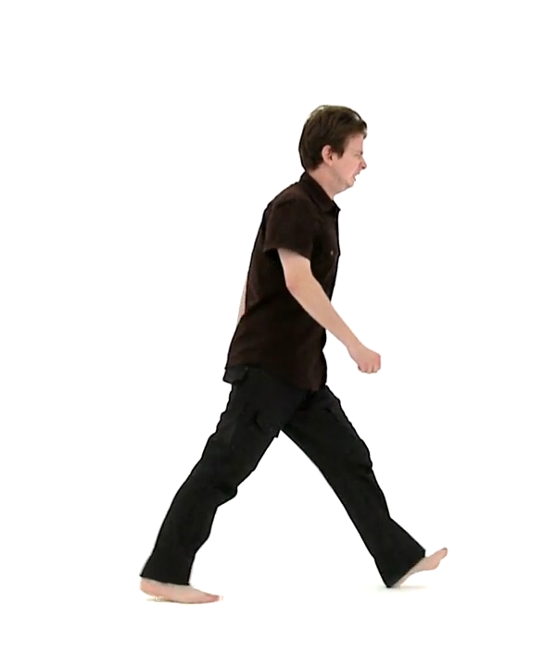
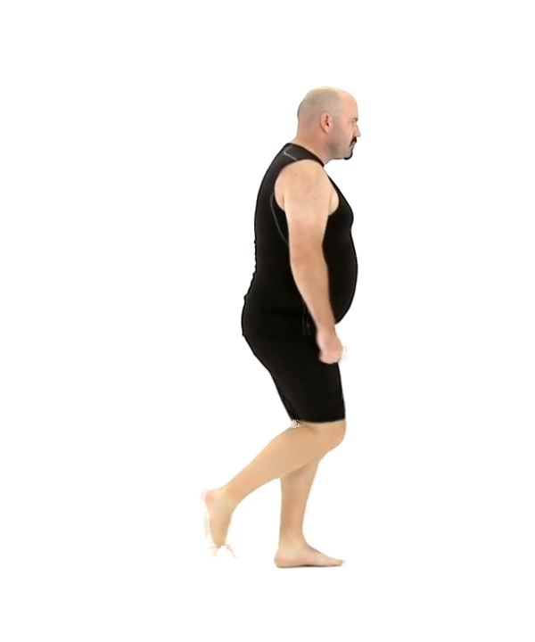
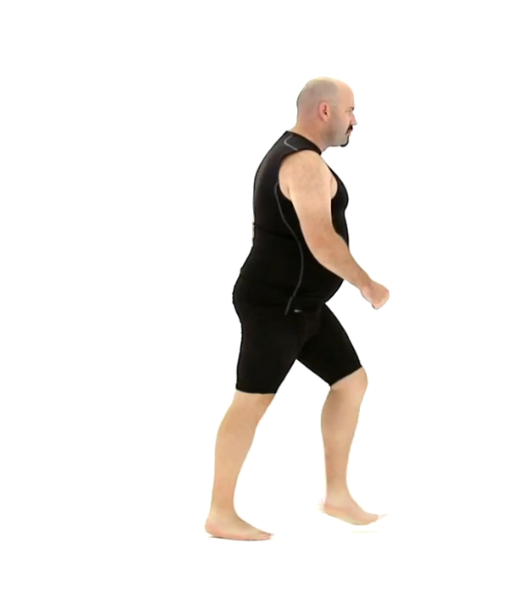

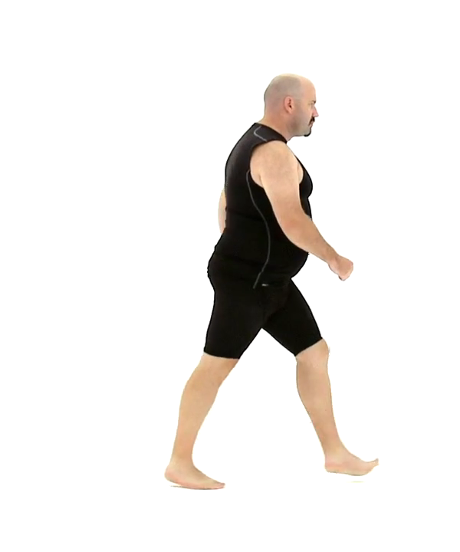

Challenges of image -> video
Tedious UI
Convenient UI
Frame 4
Frame n
Frame 2
Frame 1
Frame 3
Frame 1
Frame 2
Frame 3
Frame 4
Frame n
Notes:
Somebody may think the reason of less work on video morphing is because the video morphing is a trivial problem. It can be the direct application of image morphing on each frame pair but things are much more complicated because of the following challenges.
Firstly, direct application of image morphing requires tedious UI on each frame. Previous papers solve it by transfer the features form one to another with feature tracking.
What’s more our video morphing method leverage our recent image morphing method, which is more automatic than traditional methods , so ours can further reduce the user input on single frame compared to other video morphing method.

Slide 9
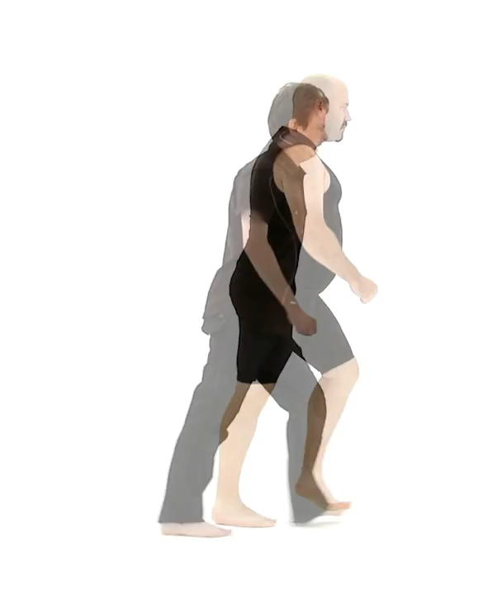
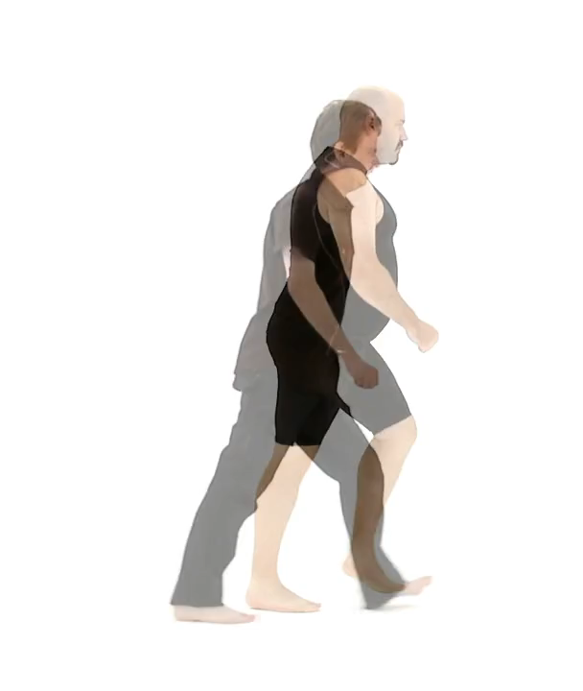
Challenges of image -> video
Unsynchronized videos
Synchronized videos
Notes:
In both earlier techniques, they assumed that the input videos are already temporally synchronized.
But in real life, the two input videos are not necessary to be temporally synchronized, as shown by the overlaid input videos on the left. Image morphing cannot applied on unsynchronized videos because it often causes topological disagreement, which are impossible to be solved by continuous mapping function.
One of our contributions is to synchronize the videos temporally to produce the intermediate result shown on the right.

Slide 10
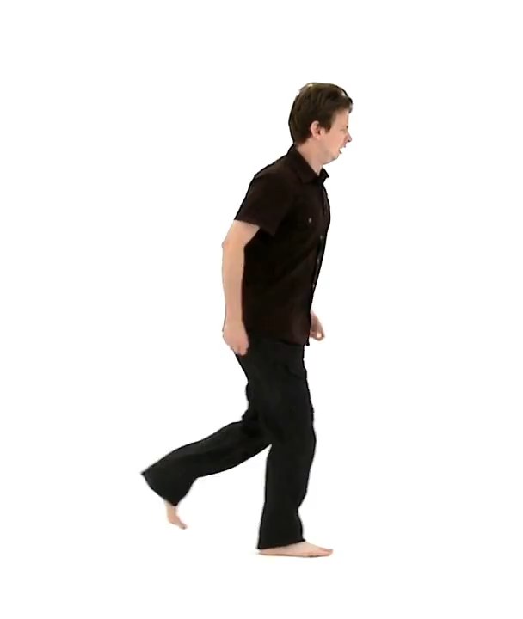

Challenges of image -> video
Popping
Smooth
Notes:
Naively applying image morphing to all the matching frame pairs after temporal synchronization may still yield visual popping artifacts. This is another challenge which hasn’t be solved by previous methods.
To ensure that the mapping between the two videos is temporally coherent over time, our method employ a temporal coherence term in our optimization energy function.

Slide 11
Contributions
Convenient UI
Temporal Synchronization
Temporal Coherence
Notes:
In summary, our work has three major contributions: convenient UI, temporal synchronization temporal coherence. The first one is partially solved by previous paper, ours further improves it, other two haven’t been tackled by previous work, ours method solves them. Next I will introduce our video morphing method.

Slide 12




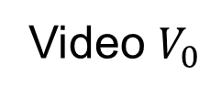


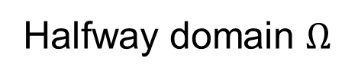
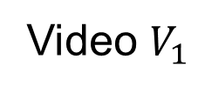


Optimization of Spatiotemporal Map
Video $V_{0}$
Halfway domain $Ω$
Video $V_{1}$
$$φ_{0}\left(p\right)=p−v\left(p\right)$$
$$p$$
$$φ_{1}\left(p\right)=p+v\left(p\right)$$
$$v\left(p\right)$$
$$φ=φ_{1}∘φ_{0}^{−1}$$
Notes:
Our video morphing use halfway parameterization to define the Spatiotemporal mapping between two videos .
The idea is to define a 3D vector field v over a 3D domain that is halfway between the two videos. For each pixel p in the halfway domain we solved for a 3D vector v(p), which means the point p-v(p) in video0 maps to p+v(p) in video1.
The advantage of the halfway parameterization is that the mapping function is defined as a single, continuous function, in comparison, previous methods defines two mapping functions, from source to destination and from destination to source.

Slide 13
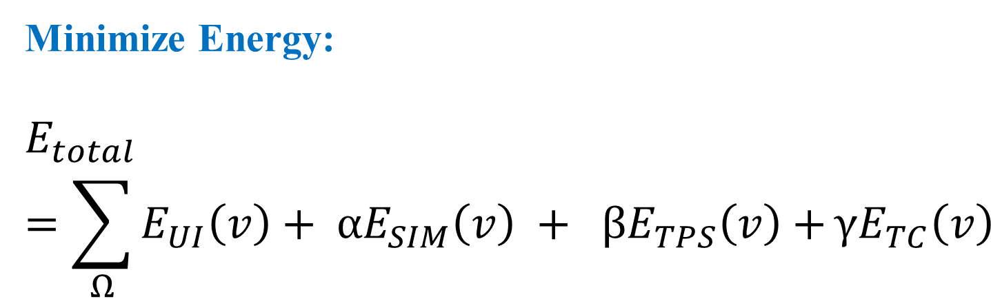
Optimization of Spatiotemporal Map
Minimize Energy:
$$E_{total}=\sum_{Ω}{E_{UI}\left(v\right)+ αE_{SIM}\left(v\right) + βE_{TPS}\left(v\right)+}{γE}_{TC}\left(v\right)$$
UI
Least squares
Similarity
SSIM variant
Smoothness
Thin-plate spline
Temporal coherence
Optical flow
Notes:
To optimize the vector field V, We define an energy function with four terms.
user-specified correspondence term, simply preserves the user defined mapping.
similarity term build on structural similarity (SSIM) measures the differences between two mapping neighbors, which encourages each pixel to find its most similar match,
Smooth term based on TPS, making the vector field to be smooth.
These there terms are inherited from our image morphing paper.
The last term Temporal coherence term build on optical flow is specially added to video morphing to ensure temporal coherence and avoid the popping effects as shown before.
,

Slide 14



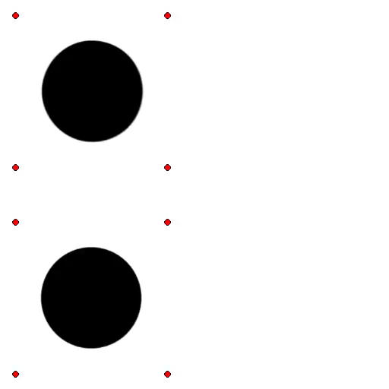
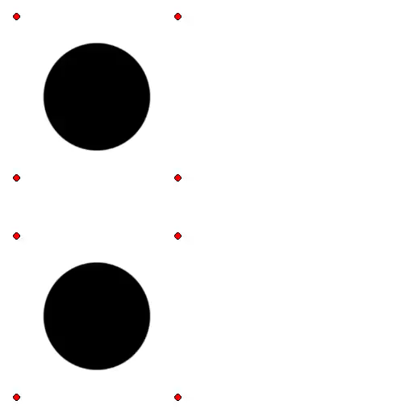
Approach overview
input
output
Temporal
Synchroni-zation
Spatial
optimization
Notes:
In our implementation to solve the vector field , we use two stage algorithm.
The first stage solves for the temporal mapping, outputs the temporally synchronized videos.
And the second step solves for the spatial alignment of each synchronized frame pair , in order to produce the final morph sequence .
The idea of solving it in two stages rather than in a single stage is because of the speed an quality concerns. We have tested the single stage algorithm is 5 times slower than the two-stage method.
Next I will introduce the two stages in more details.

Slide 15

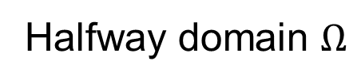
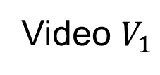
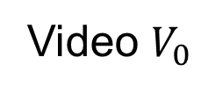
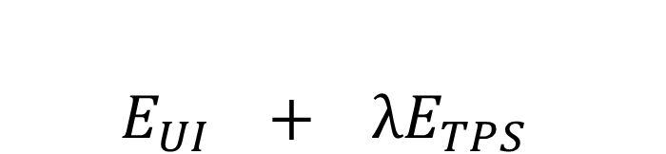
Stage1: Temporal synchronization
$$E_{UI} + λE_{TPS}$$
Energy Function:
Video $V_{0}$
Halfway domain $Ω$
Video $V_{1}$
$$v\left(p\right)$$
Notes:
In the first stage, we optimize the 3D-valued vector field v over the 3D domain based on TPS term and UI term only, omitting the costly similarity term and temporal coherence term, because the aim of this stage is to find a smooth temporal correspondence map between the two videos, the crude spatial alignment guided by the sparse user-specified points is enough.

Slide 16

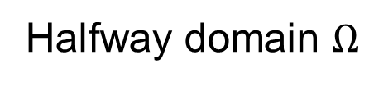

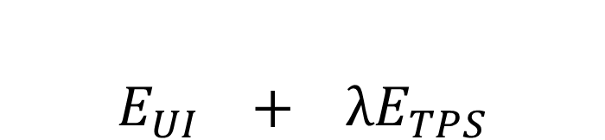
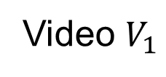

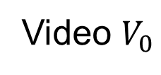


Stage1: Temporal synchronization
$E_{UI} + λE_{TPS}$
Energy Function:
Video $V_{0}$
Halfway domain $Ω$
Video $V_{1}$
$$p−v\left(p\right)$$
$$p$$
$$p+v\left(p\right)$$
$$p−v_{ui}$$
$$p+v_{ui}$$
Notes:
The energy for this stage has two terms. The first term based on user specified correspondences. For example, this is one user specified correspondences. We measure the distance between the current vector and user specified correspondences. As the purple lines shows.

Slide 17
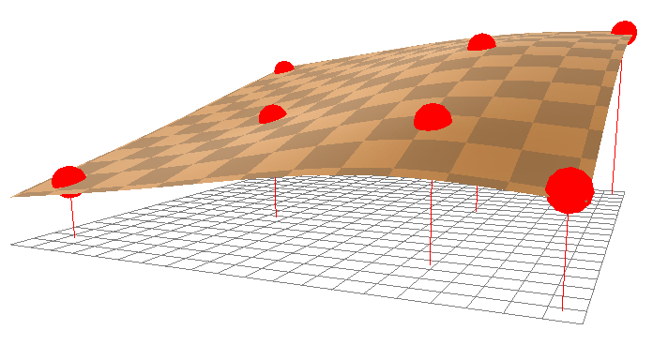
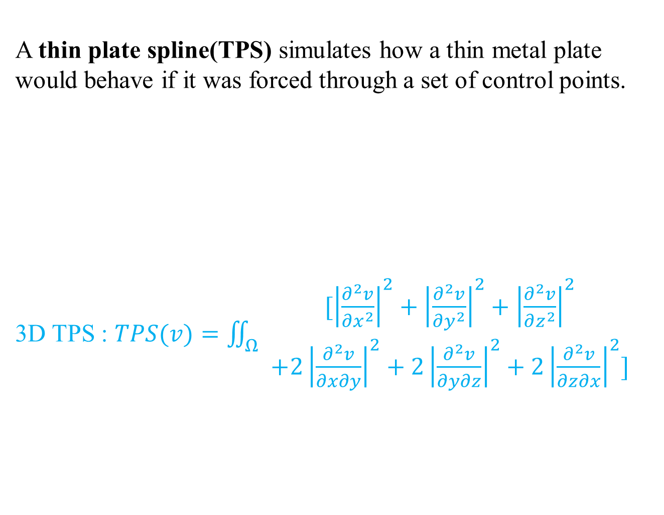
Stage1: Temporal synchronization
$E_{UI} + λE_{TPS}$
Energy Function:
A thin plate spline(TPS) simulates how a thin metal plate would behave if it was forced through a set of control points.
3D TPS : $TPS(v)=\iint_{Ω}{\begin{aligned}[{\left|\frac{∂^{2}v}{∂x^{2}}\right|}^{2}+{\left|\frac{∂^{2}v}{∂y^{2}}\right|}^{2}+{\left|\frac{∂^{2}v}{∂z^{2}}\right|}^{2} \\ +2{\left|\frac{∂^{2}v}{∂x∂y}\right|}^{2}+2{\left|\frac{∂^{2}v}{∂y∂z}\right|}^{2}+2{\left|\frac{∂^{2}v}{∂z∂x}\right|}^{2}]\end{aligned}}$
Notes:
To interpolate the user specified correspondences we use the 3D thin-plate-spline. Minimizing this function gives us the smooth vector field satisfying the user input constrains.

Slide 18

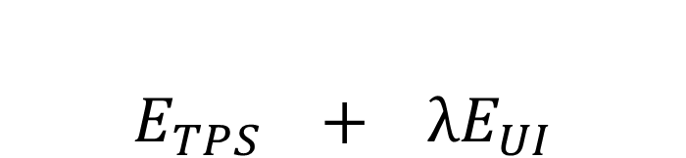
Stage1: Temporal synchronization
$E_{TPS} + λE_{UI}$
Energy Function:
Video $V_{0}$
Halfway domain $Ω$
Video $V_{1}$
$$vt\left(p\right)$$
Notes:
After optimization, we then get the vector field. We use the temporal component $vt\left(p\right)$ to temporally resample the input videos. In other word, we temporally map two videos to the halfway domain, thus synchronizing them while not spatially advecting their content.
Please note our synchronization is pixel variant, it can satisfy the different synchronization requirements of different parts in the video.

Slide 19
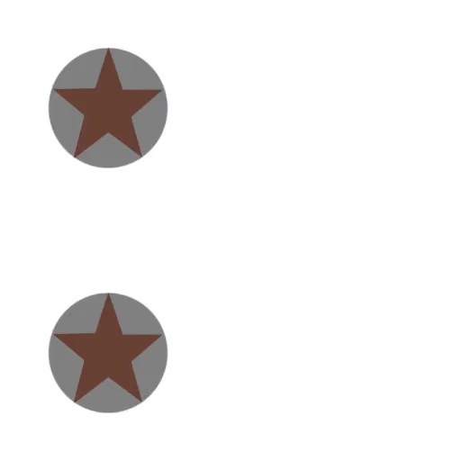
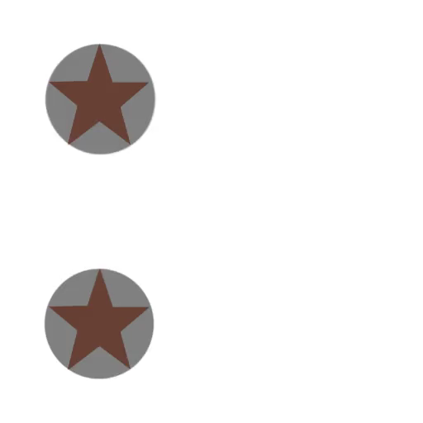
Stage1: Temporal synchronization
before synchronization
after synchronization
Notes:
Just as this example, pixels belonging to the objects on the top are brought into synchronization without affecting the already synchronized objects on the bottom.

Slide 20
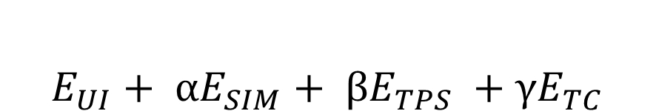



Stage2: Spatial optimization
$${{E_{UI}+ αE}_{SIM}+ βE}_{TPS} +γE_{TC}$$
Energy Function:
Video $V_{0}$
Halfway domain $Ω$
Video $V_{1}$
$$p−v\left(p\right)$$
$$p+v\left(p\right)$$
$$v\left(p\right)$$
Notes:
In the second stage, our approach spatially aligns the features of the videos. Here we solve an optimization over the 3D domain. but using only a 2D-valued vector field v_xy. We let the temporal components to be zero, because the video is already synchronized and we want the mapping happens between the synchronized frame pairs.
To solve this we introduce the four terms. Of energy function. The UI term and TPS term is same as in the first stage, except for the degeneration from 3d to 2d, so I am not going to repeat, I will introduce other two terms only used in this stages.

Slide 21


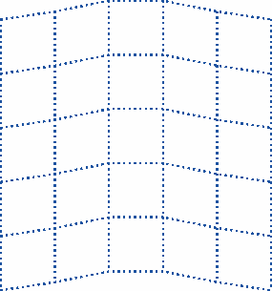
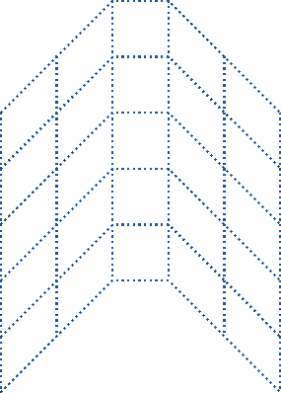
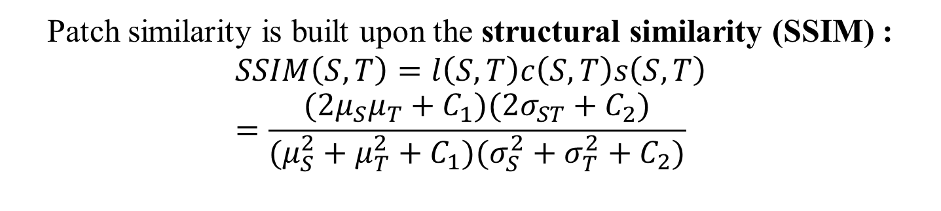
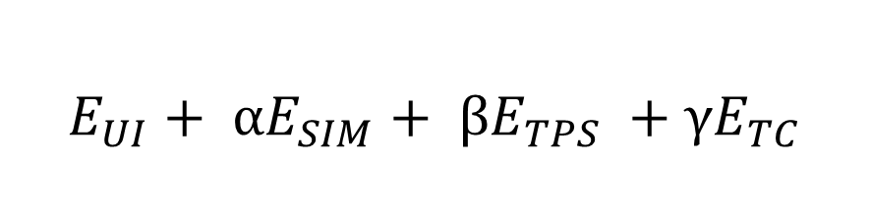
Energy Function
$${{E_{UI}+ αE}_{SIM}+ βE}_{TPS} +γE_{TC}$$
Patch similarity is built upon the structural similarity (SSIM) :
$$SSIM\left(S,T\right)=l\left(S,T\right)c\left(S,T\right)s\left(S,T\right)=\frac{(2μ_{S}μ_{T}+C_{1})(2σ_{ST}+C_{2})}{(μ_{S}^{2}+μ_{T}^{2}+C_{1})(σ_{S}^{2}+σ_{T}^{2}+C_{2})}$$
Notes:
One important term for spatially alignment is the similarity term which attempts to match pixel with similar neighborhoods.
This term is build on structural similarity (SSIM). SSIM is an index measuring the perceptual difference between two images. In our implementation we run the SSIM on a small 5x5 patch around the pixel.
SSIM measures the similarity from three aspects: luminance, contrast and structure. But we have modified the original definition a bit in order to make it work for many compelling cases. For the details of our modifications, please refer to our image morphing paper.

Slide 22



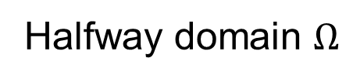

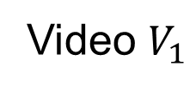


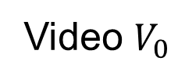
Stage2: Spatial optimization
$${{E_{UI}+ αE}_{SIM}+ βE}_{TPS} +γE_{TC}$$
Energy Function:
Video $V_{0}$
Halfway domain $Ω$
Video $V_{1}$
$$q−v\left(q\right)$$
$$q+v\left(q\right)$$
$$q$$
frame t-1
frame t
$$p$$
$$p−v\left(p\right)$$
$$p+v\left(p\right)$$
Notes:
The last term of temporal coherence is build on optical flow, which is important to guarantee the temporal smoothness.
This term is defined like this.
During optimization of a point $p$ in the halfway domain of the current frame, we seek to find the point $q$ in the previous frame that corresponds to $p$ based on optical flow.
Then we advect the two matching points from the previous frame of both input videos, shown in yellow in the current frame. The difference between the advected yellow points and the matching points in the current frame represent the temporal coherence energy.
The idea is that the two mapped pixels in previous frame should also be mapped in this frame after being advected by optical flow.

Slide 23

Stage2: Spatial optimization
Without E_{TC}
With E_{TC}
Notes:
Here is the final result after spatial optimization.
The example on the left does not include the temporal coherence term, and thus results in popping artifacts. The result on the right with temporal coherence term looks much smoother.

Slide 24
Responsive UI
Notes:
Next I will show the results of our methods. Starts from the responsive UI.

Slide 25
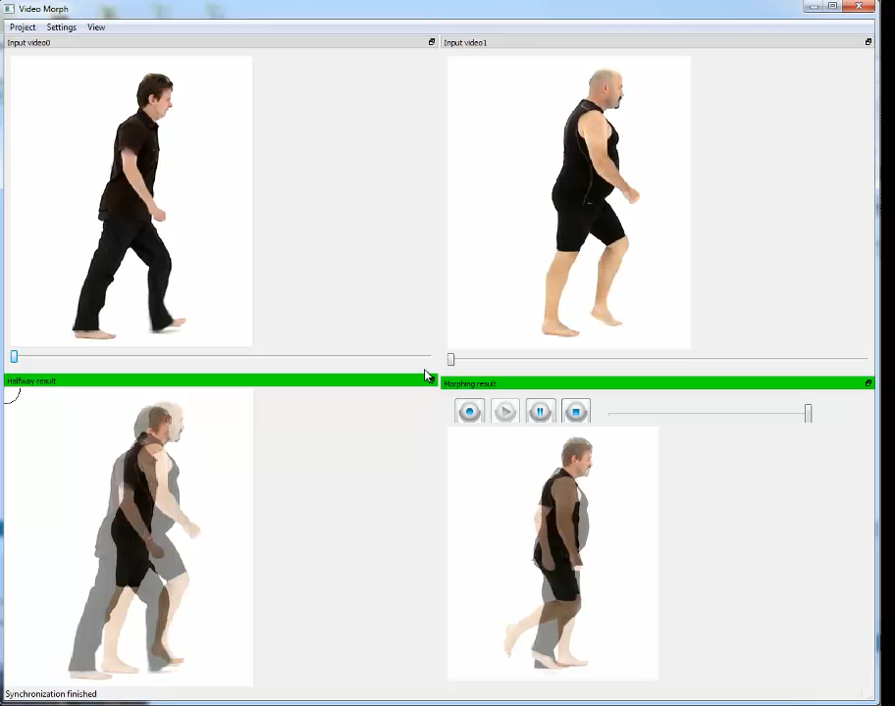
Speed:5x
Notes:
Here is our user interface, we take two video as inputs, shown in the top two windows. The morphing results are shown in the bottom windows. We can see they are neither temporally nor spatially aligned.
User can specify correspondence points on input videos. WE will automatic propogate it by optical flow. Futher user corrections are cause by inaccurate optical flow.
This shows our first stage, after several clicks, the two input videos are aligned.
After the first stage, we can go to next stage. All the control points are automatically carried to next stage. No need to specify more but if user want, he can refine them or add new point.
We automatically propagate correspondence points to all other frames by optical flow .
This stage takes longer than the first stage, because the similarity term is costly. We use GPU to accelerate it, to make it about 2-4 minutes.
Now the second stage finished. And the video are both temporally and spatially aligned, the final results morphing is shown here.

Slide 26
Results
Notes:
Here are some more results.

Slide 27
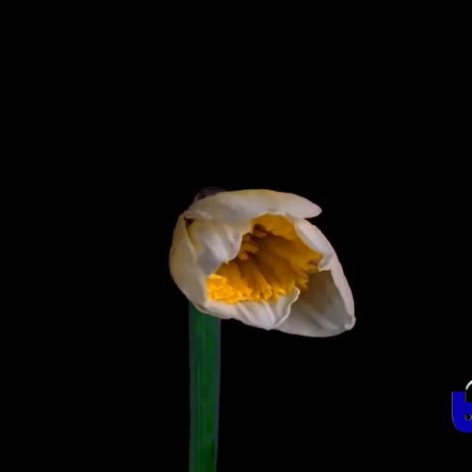

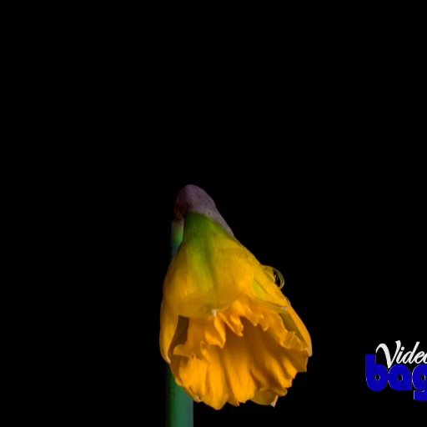
Duration | 80
Points | 5
Total clicks | 16
Notes:
The two videos on the left are input videos, and the right one is our result. The table on the top-right corner shows that duration of video, and the number of correspondences points specified by user and the total adjustments of the points by users.

Slide 28
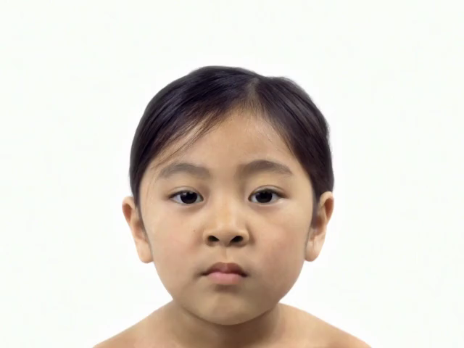
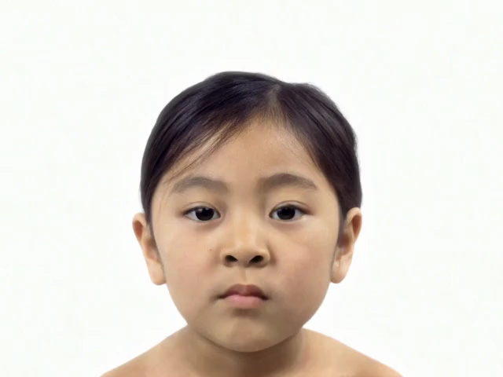
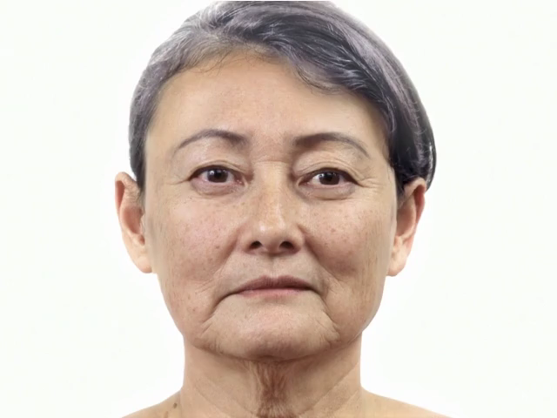
Duration | 160
Points | 7
Total clicks | 28
Notes:
The two videos on the left are input videos, and the right one is our result. The table on the top-right corner shows that duration of video, and the number of correspondences points specified by user and the total adjustments of the points by users.

Slide 29
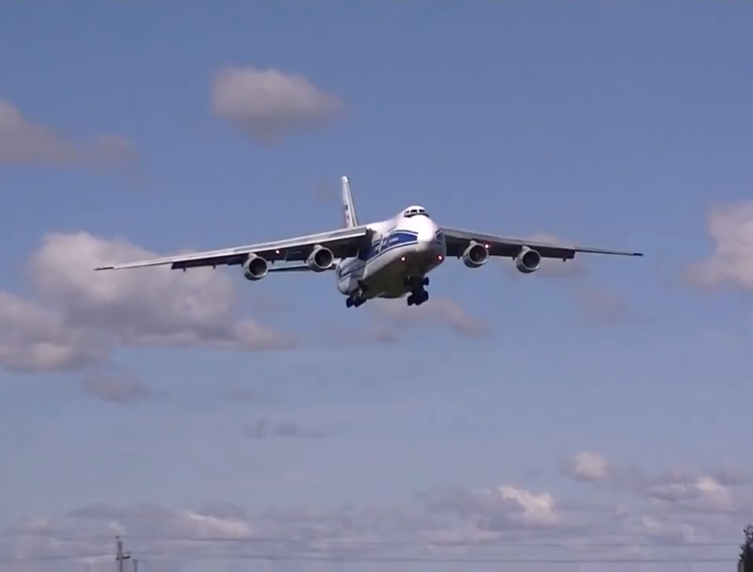

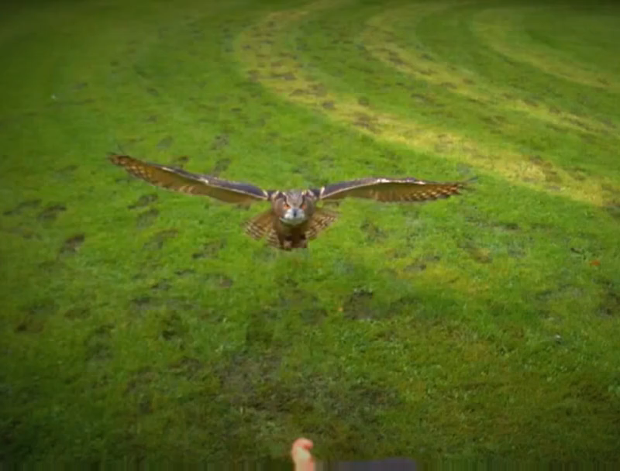
Duration | 80
Points | 8
Total clicks | 18
Notes:
The two videos on the left are input videos, and the right one is our result. The table on the top-right corner shows that duration of video, and the number of correspondences points specified by user and the total adjustments of the points by users.

Slide 30



Duration | 100
Points | 8
Total clicks | 32

Slide 31



Duration | 110
Points | 8
Total clicks | 37

Slide 32


before synchronization
after synchronization
Notes:
Here are some results show the two stages of our method. This is the synchronization stage. We can see the motion are synchronized after the first stage temporal synchronization.

Slide 33



Duration | 70
Points | 6
Total clicks | 40
Notes:
And here we see the final morph after spatial optimization.

Slide 34


before synchronization
after synchronization
Notes:
Here is one more example.

Slide 35



Duration | 80
Points | 11
Total clicks | 48

Slide 36


before synchronization
after synchronization

Slide 37



Duration | 80
Points | 10
Total clicks | 78

Slide 38
Failure cases
Notes:
Next, we show some scenarios that are too challenging for our algorithm.

Slide 39



Duration | 80
Points | 3
Total clicks | 20
Notes:
If there are significant topological differences between the videos, a continuous mapping is not achievable.

Slide 40



Notes:
In the top example, the arm extends beyond the body of the subject, unlike in the bottom example.
This makes it impossible to generate a continuous mapping between the two videos without blending the background of the top example with the foreground of the bottom example.

Slide 41


before synchronization
after synchronization
Notes:
In this example, the first stage can successfully synchronize the two weight lifters.

Slide 42



Duration | 80
Points | 14
Total clicks | 86
Notes:
However, due to the significant shift in the background, the resulting spatially optimized morph has undesirable distortions. This can only be addressed by masking the background prior to performing the morph.

Slide 43
More results
Notes:
Finally,Let me conclude this paper while playing more results.

Slide 44



Duration | 80
Points | 10
Total clicks | 34
Duration | 70
Points | 7
Total clicks | 26
Duration | 70
Points | 8
Total clicks | 31
Duration | 70
Points | 11
Total clicks | 36
Duration | 70
Points | 14
Total clicks | 45
Duration | 70
Points | 11
Total clicks | 32
Notes:
Our semi-automated vide morphing has three major contributions: requiring less user inputs, synchronizing input videos and making the final morph temporally coherent.
The limitation is it cannot solve the occlusions by continuous mapping.
In future work, we would like to explore the possibilities of allowing discontinuities in our mapping, to address situations in which there is occlusions, like disagreement between foreground and background motions.

Slide 45
Thanks!
Q&A

